Slide 1
Skills Development
Bethuel Lebeya
Chief Technology Officer
23 November 2021

Slide 2
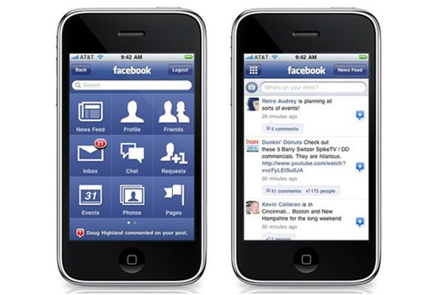
Mobile Application vs Web Application
Application Native
Application Web
https://blog.pandasuite.com/native-app-vs-web-app/

Slide 3
Understanding the difference between
Client vs Consumer
Pure Mobile Application
Pure Mobile Website
Accessed after being installed |  |  | Accessed through browsing
Interactive user interface |  |  | Navigational user interface
Available offline |  |  | Requires connection
Better user engagement |  |  | Attract larger audiences
Relatively expensive |  |  | Relatively inexpensive
Can make use of phone features |  |  | Somewhat limited features

Slide 4
Smartphone Users
https://www.statista.com/statistics/330695/number-of-smartphone-users-worldwide/

Slide 5
Where did the skill come from?
Industry
University
Interoperability Services Portal
6
Representation Layer
Study Course Services
Analysis Services
Study Course Rating Services
Study Course Services
Difference Services
Tendencies Analysis Services
Knowledge Requirements Repository
2
5
Knowledge Requirements Identification Services
UKRDM Services
Study
Courses
Occupational Standards
Occupational Standard Services
Knowledge Requirements Identification Services
UKRDM
System Maintenance Services
Job Description Services
Job
Descriptions
Certification
Courses
Certification Course Services
UKRDM Maintenance Services
Other Information Acquisition Services
1
3
4
Service Layer
www.researchgate.net

Slide 6
My Personal Experience
System and Configuration Testing
Front End Application
Workflow Testing
Workflow Orchestration
Service Testing
Services
Integration Testing
Data Service / Messaging
Automated Testing
Data Abstraction
Performance Testing
Cloud Services
Legacy
Database
Adoption of Continuous Integration
and Continuous Delivery
Private and Confidential
Notes:
Brief reminder on our knowledge and approach, and how our SDETs is fit for purpose.
Any system / application and area
Staff retention

Slide 7
Implementation of Applications
in the Cloud
Pillars
Operational Excellence
Get Videos and Documentation related to AWS best practices
Security
Reliability
AWS Well-Architected Tool
Review your answers against the five pillars established by the Well-Architected Framework
Generate a report that summarizes your workload review
Identify the workload to review
Then answer a series of questions about your architecture
Performance Efficiency
Cost Optimisation
View the results of workload reviews across your organisation in a single dashboard
www.aws.com

Slide 8
Implementation
Product Management
Agile Team, Engineering, Tools, Business Owners, Scrum Master, SME’s, DevOps, Automation, Tooling Standards, Principles, HLD’s, Runbooks
Document Working Requirements
Create and Assign Task
Development
Software Build; CI / CD, Containers, VM’s, Cloud Native, Branching, Packaging, Testing, Security, Vulnerability Scanning
Plan Feature
Write Code
Build
Test
Operations
Testing, Release Management, Reliability Management
IaC Build, CFT, SAM, Templates, EC2, VPC
Deploy
Release
Operate
Monitor
ITSM, Monitor, Logging, Tickets, Resolution, FAQ’s, Remediation

Slide 9
Notes:
Close presentation shortly after this slide to bring the human factor back – video on so you can see their expressions while answering questions.
This slide gives the impression we are presenting this to others as well – which helps with subliminal message for the buyer to take the deal.

